Slide 1
A DSL for your API
Presented by Gregory M. Sohl
@gregsohl

Slide 2
What’s a DSL?
A language that is specific / custom - to meet your application’s needs

Slide 3
Why would I add scripting to my app?
Automation
Add agility to your applications
Testing

Slide 4
Who Scripts??
Excel / Office (using VBA)
Install Tools (using Lua, Pascal, other)
Salesforce.com (using Apex)
Others??

Slide 5
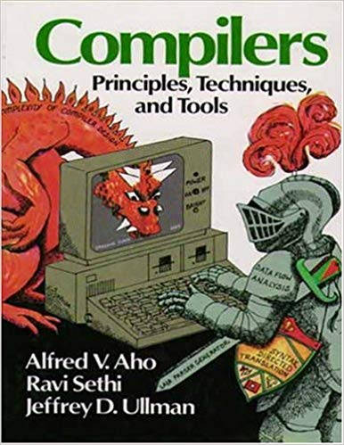
Have you created a language before?
CompSci 201
Dragon book

Slide 6
That’s hard!
Handwritten parsers
CompSci Theory - There’s dragons in there!
Generated parsers / lexers
Tools have improved

Slide 7
Compilers and Interpreters
What’s the difference?
What should I build?

Slide 8
Today’s App
TurtleGraphics.NET
https://nakov.com/blog/2016/02/14/turtle-graphics-net-csharp-open-source-library/
https://github.com/nakov/TurtleGraphics.NET

Slide 9
The API
Forward(distance)
Backward(distance)
MoveTo(x, y)
Rotate(angle)
RotateTo(angle)
PenUp(void)
PenDown(void)
PenColor(color)
PenSize(size)
Current Pen X
Current Pen Y
Current Angle
ShowTurtle(bool)
DrawingDelay(int milliseconds)
Clear()

Slide 10
You said there were new tools, right?
ANTLR4
Who uses it?
  Salesforce.com – Apex language
  Hibernate - HQL language
  Twitter - Search query language
  Apache Cassandra – CQL language
  Apache Groovy language
  Team Foundation Server - Source search language parsers

Slide 11
The ANTLR (R)evolution
Terence Parr - CompSci prof at University of San Francisco
Building language tools since 1989

Slide 12
The ANTLR4 Advantage
Simplified grammar - readability
Recursion issues nearly obliviated
  Automatically rewrites left-recursive rules
Eliminates need for but still allows code snippets as actions in the grammar file.
Generates Parse Trees and Tree Walkers
  Generates Listener code - event driven, like a SAX parser for XML
  Generates Visitor code, where you control the walking of the Parse Tree
Great documentation, including two available books by Parr
BSD License

Slide 13
Let’s build a language

